Slide 1
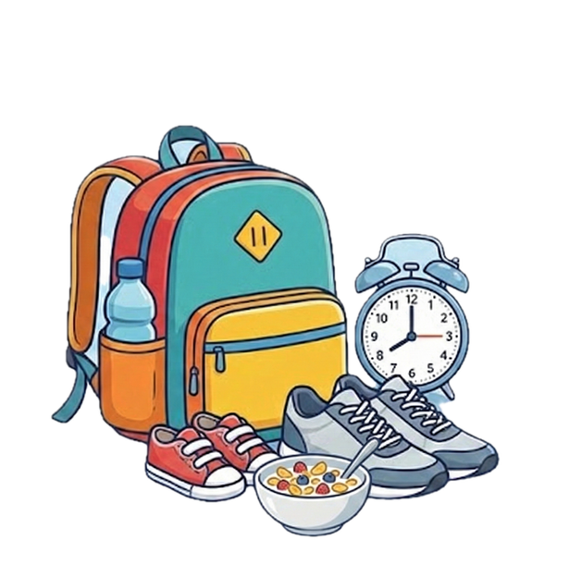


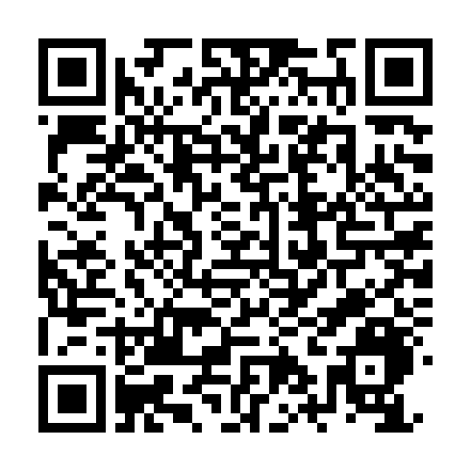
WIN £100 AND HELP IMPROVE THE MORNING SCHOOL RUN!
We have been selected by the Department for Education to help design a national Breakfast Club programme that works for every family’s morning school run.
THE ASK
A 10 minute
online survey.
WHO
Everyone! We’re really interested to hear from those who don’t use the breakfast club too!
Designed by parents, for parents
Scan this QR code, complete the 10 minute survey and have the chance to win £100!
Help ensure breakfast clubs work for all families!

